Slide 1


Database Modeling Alphanumeric
11th – 12th October 2018

Slide 2
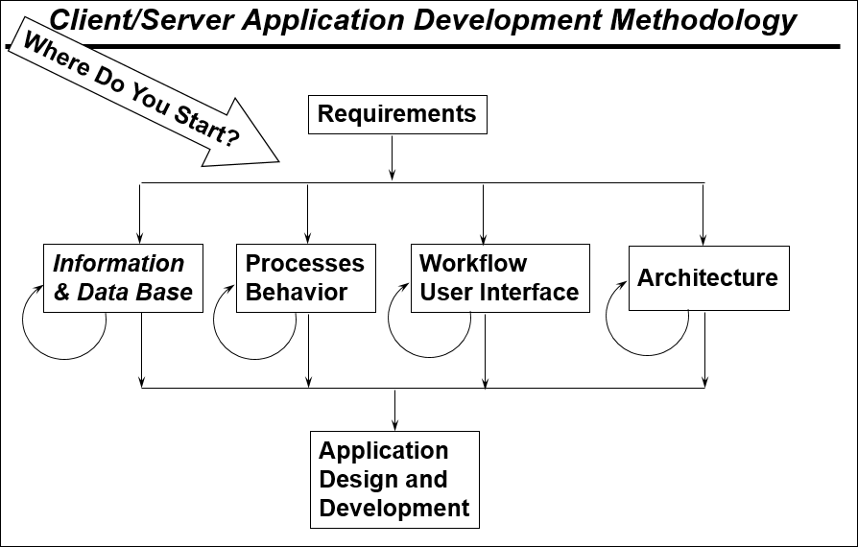
Database Modeling (Alphanumeric)

Slide 3
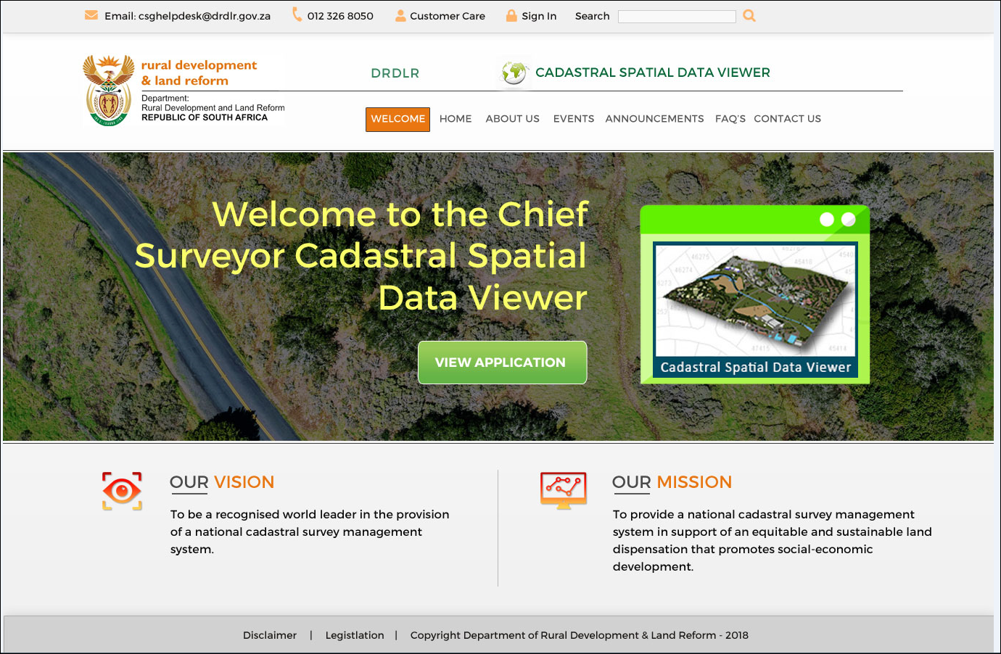
Web Portal functionalities

Slide 4
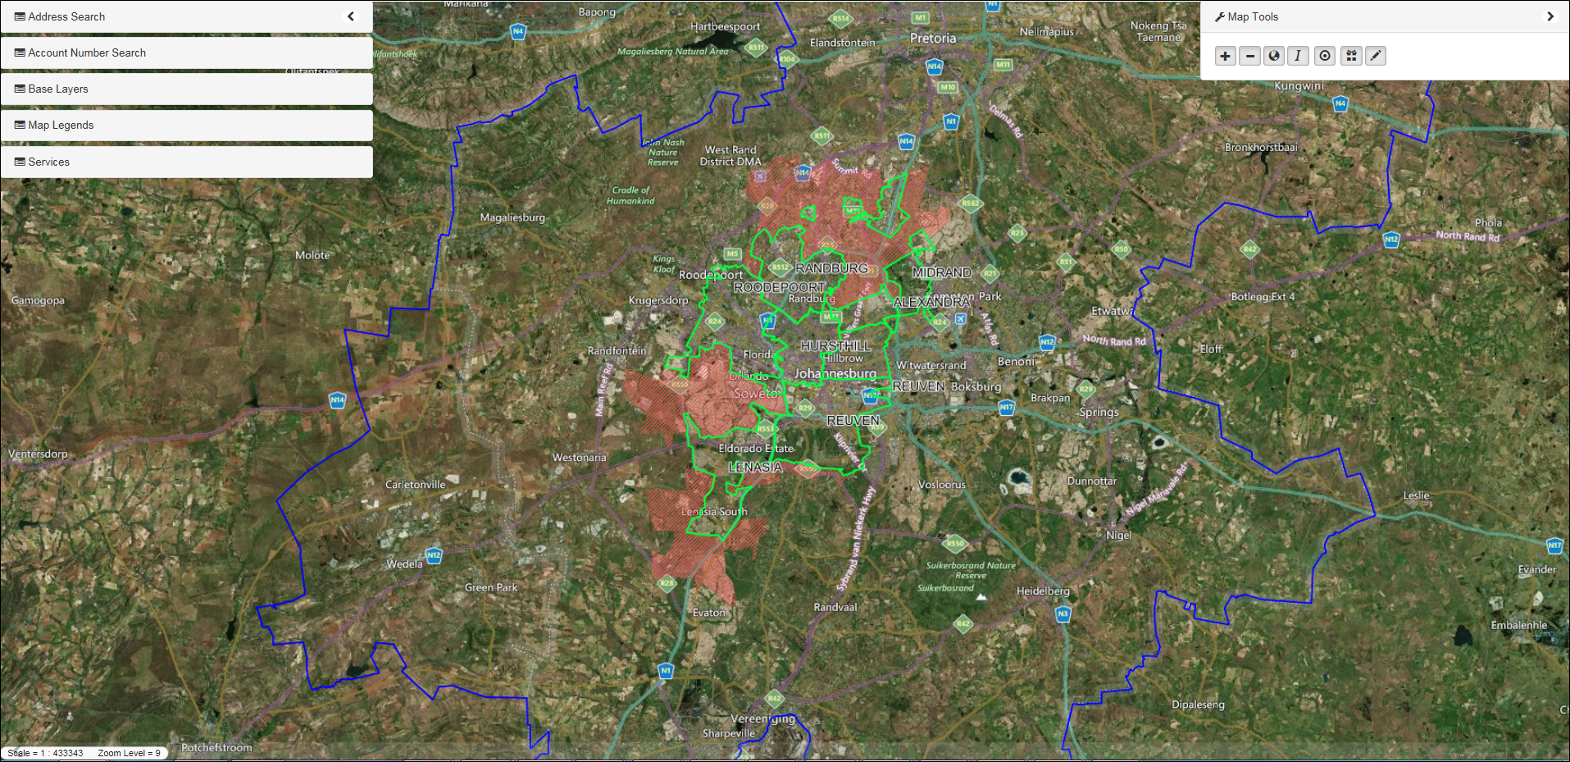
Web Portal Spatial Viewer

Slide 5
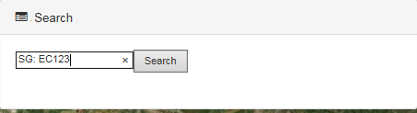
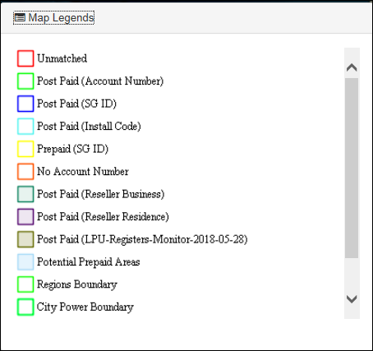
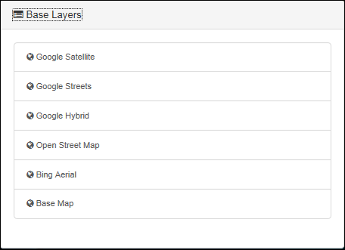
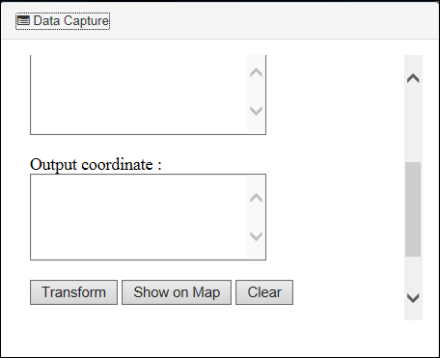
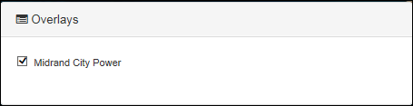
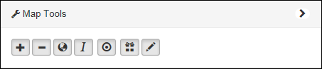
Web Portal Search

Slide 6
Web Portal

Slide 7
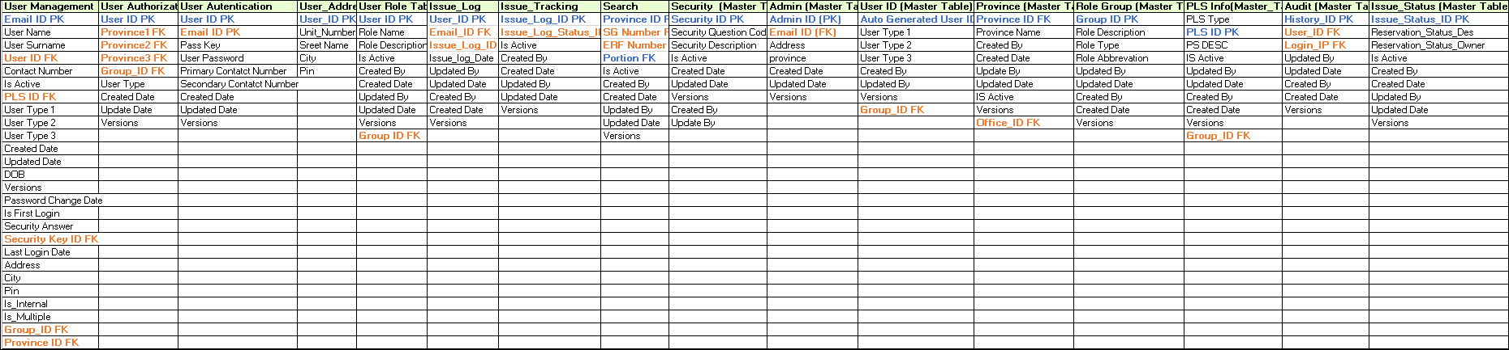
Web Portal database tables with Primary and Foreign Key Details

Slide 8
User Access Management

Slide 9
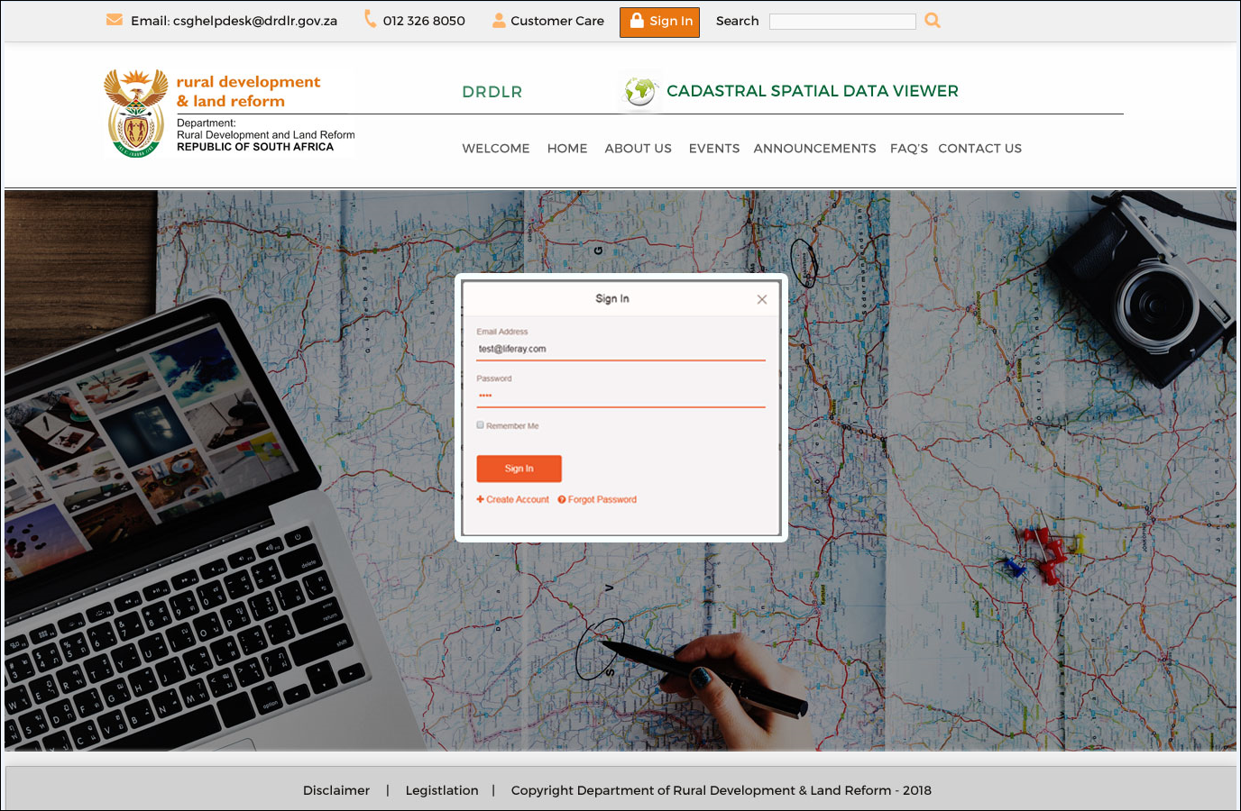
User Access Login Page

Slide 10
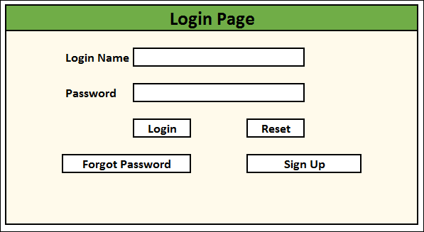
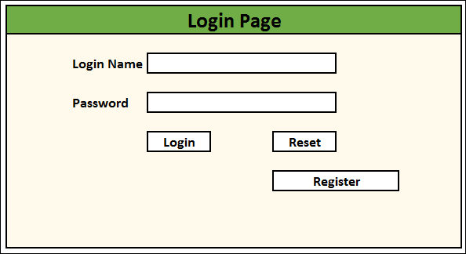
User Access Management Process Flow
This is the login page for registered user.
By clicking on register any unregistered users can make the registration and login with the credentials.
By clicking on register link this will lead to account request form page.

Slide 11
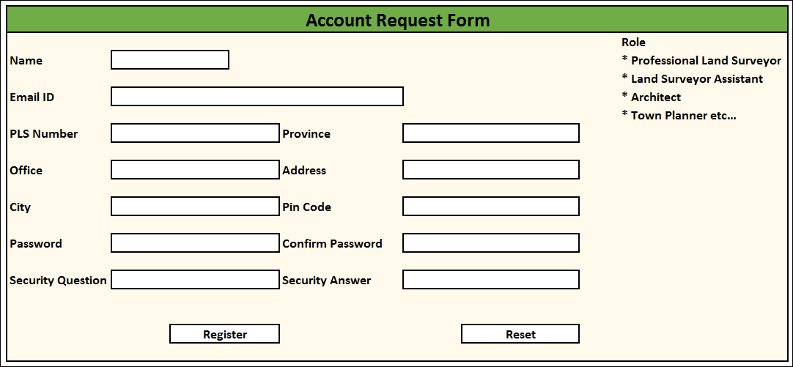
User Access Management Process Flow
In the account request form choose your role and enter requested details and click on register
The system validates the information you provided, then confirms the registration and sends a confirmation mail.

Slide 12
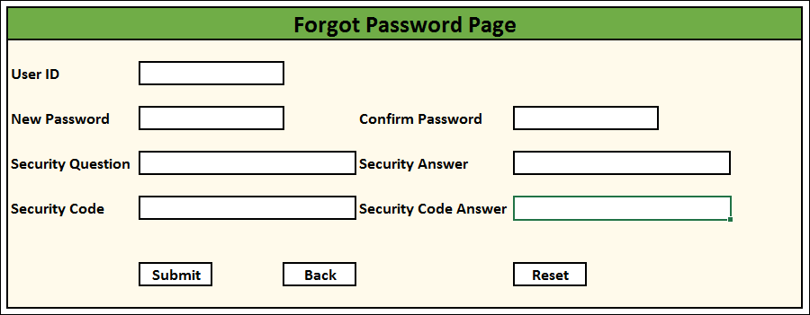
User Access Management Process Flow
When internal user inputs correct username and the incorrect password
The system shows the error of invalid username or password then user can click on forgot password button.
System displays the page where user needs to answer the security questions they had set during account creation.
User answers the said questions and clicks on submit and user now successfully reset the new password.

Slide 13
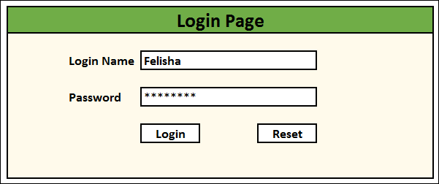
User Access Management Process Flow
Successful registered user can able to login to the application by providing there credentials.

Slide 14
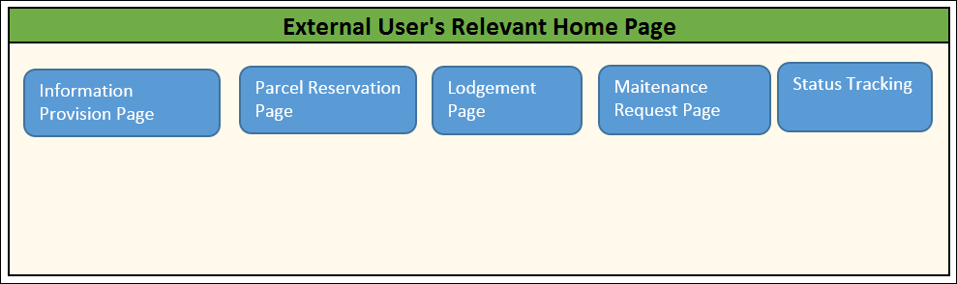
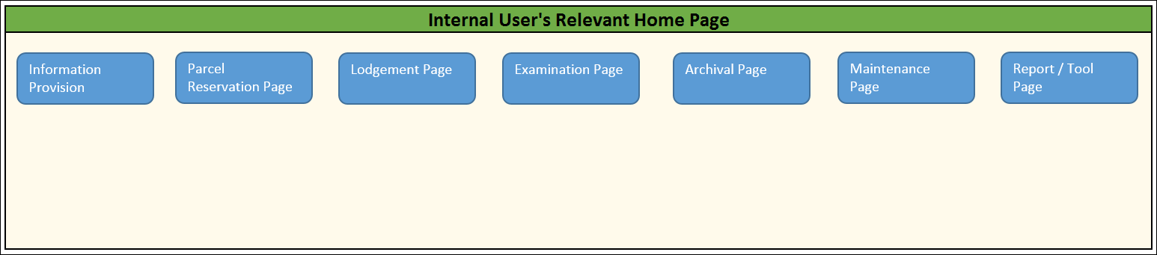
User Access Management Process Flow
once successful login the user can access the relevant home page and perform the necessary operations accordingly.

Slide 15
User Access Management

Slide 16
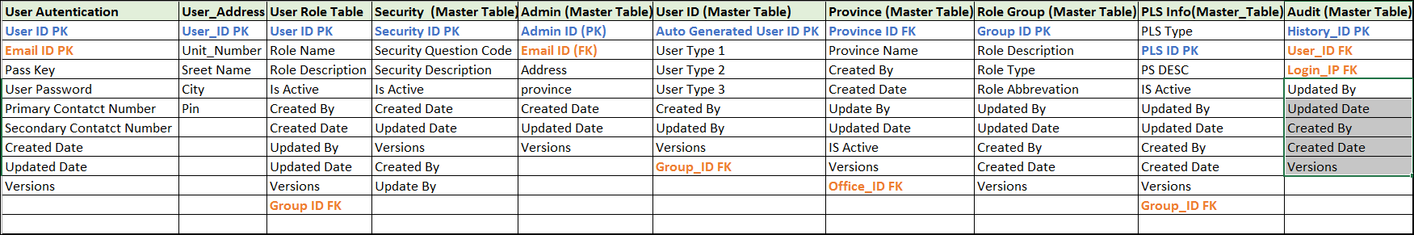
User Access Database Tables with Primary and Foreign Key

Slide 17
Information Provision

Slide 18
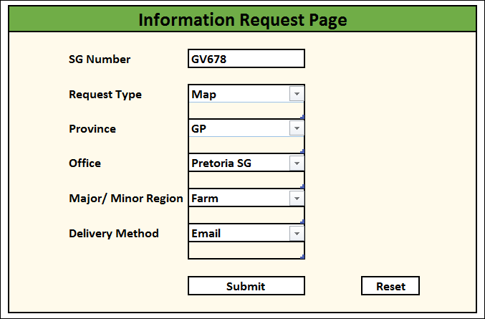
Information Provision Process Flow
After successful login user can request for information in the information request page by providing requested details.

Slide 19
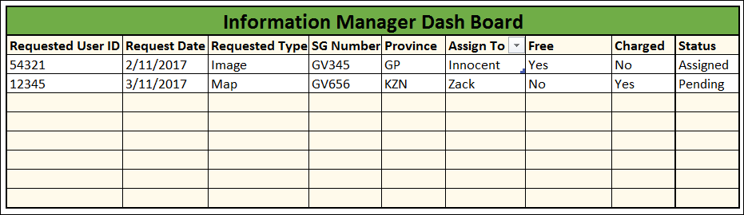
Information Provision Process Flow
Once the user submit the information request it will route the request to information manager to assign the request to the information officer in order to carry out necessary action and fulfil the request.

Slide 20
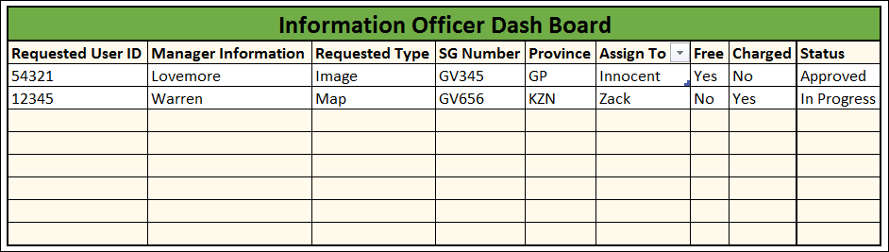
Information Provision Process Flow
After receiving the request from information manager verify the following
Estimation cost
Delivery service
Generate the pro forma invoice and get the necessary approval from information manager.
Once the request has been approved the information officer will route the pro forma invoice to the requestor.
Once the proof of payment received from requested user information officer will provide data Provision for the request user else in case invalid payment notify user.
update the status and closure the request.

Slide 21
Information Provision

Slide 22
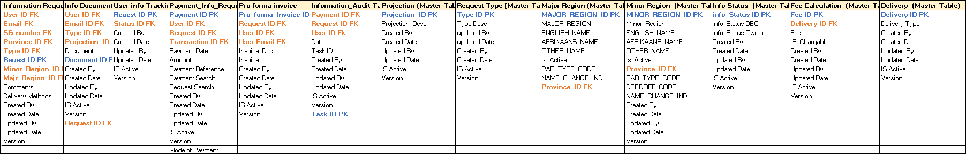
Information Provision Database Tables with Primary and Foreign Key

Slide 23
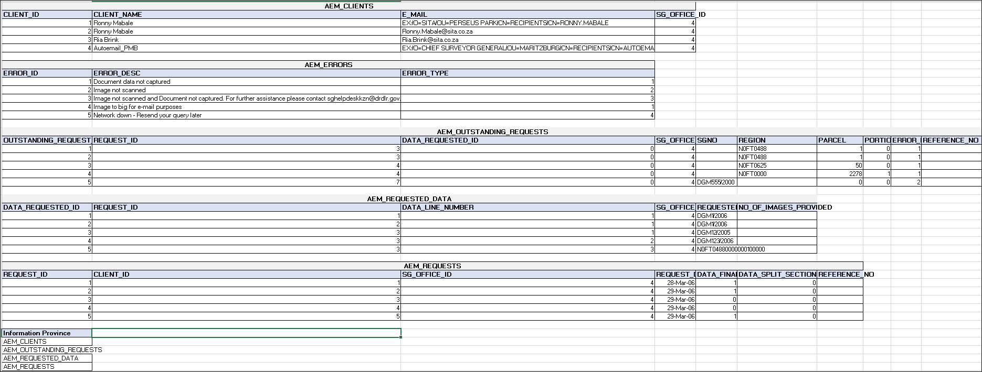
Existing Production Tables Details

Slide 24
Parcel Reservation

Slide 25
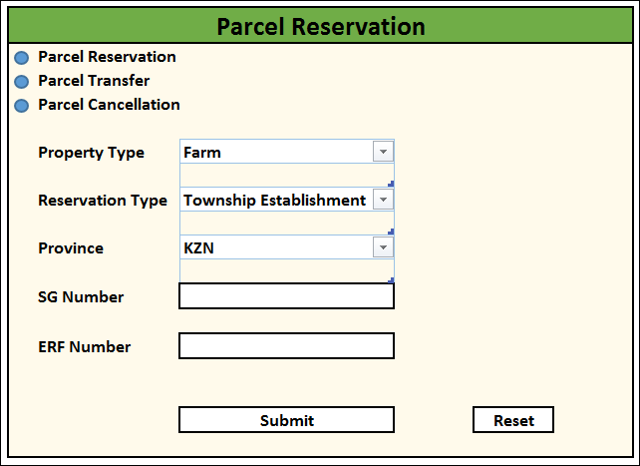
Parcel Reservation Process Flow
After successful login user can request for parcel reservation by providing requested details.
If requested parcel is already reserved system will show user notification please contact system admin.

Slide 26
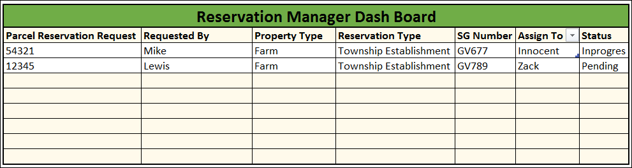
Parcel Reservation Process Flow
Once the user submit the request it will be routed to reservation manager to assign the request to the reservation officer in order to carry out necessary action and fulfil the request.

Slide 27
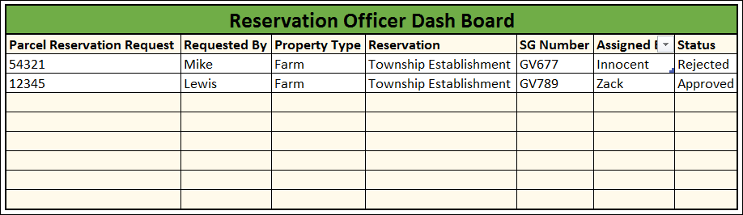
Parcel Reservation Process Flow
Reservation officer will receive the request assigned by reservation manager and perform the necessary validation and reserve the parcel.
Notify the reservation manager and requested user.
Update the status of the request.
Proceed with numbering process.

Slide 28
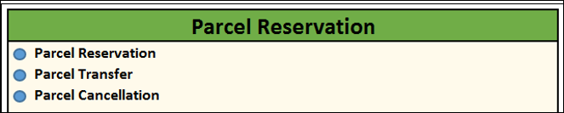
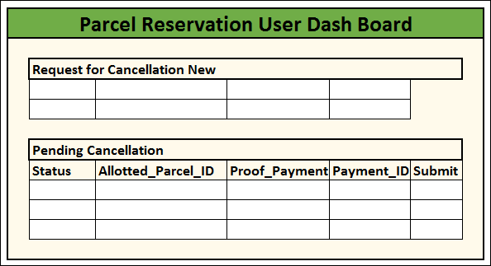
Parcel Reservation Process Flow
user can request for parcel cancellation and can view status.

Slide 29
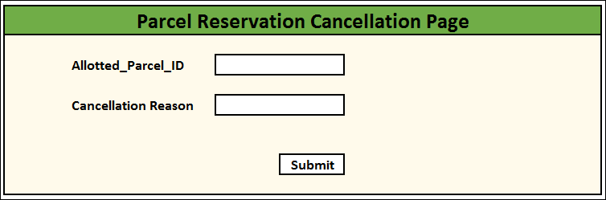
Parcel Reservation Process Flow
User has to provide required details for parcel reservation cancellation and click the submit will be routed to reservation manager

Slide 30
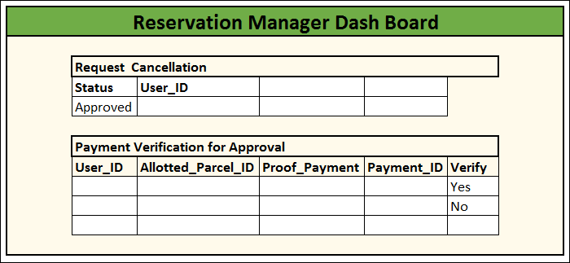
Parcel Reservation Process Flow
Once reservation manager receive the parcel reservation cancellation request valid the below.
Verify the user id vs allotted parcel id.
Parcel reservation cancellation should not have any associated with lodgement id
Generate pro forma invoice and notify requestor.
Validate proof of payment.
Update the parcel reservation cancellation process.
Update status
Closure request.

Slide 31
Parcel Reservation

Slide 32
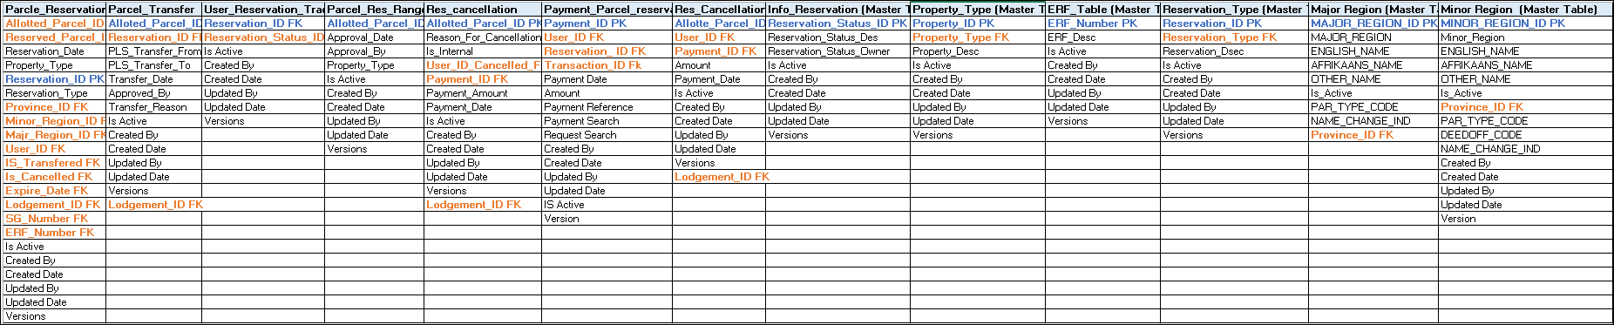
Parcel Reservation Database Tables with Primary and Foreign Key

Slide 33
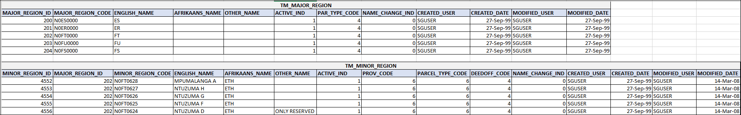
Existing Production Tables Details

Slide 34
Lodgement

Slide 35
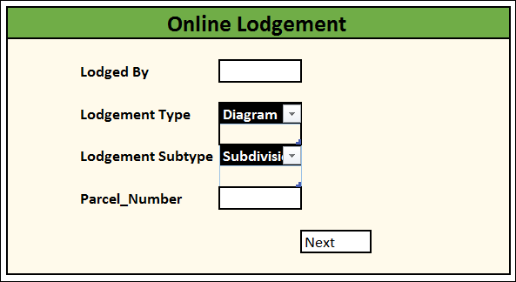
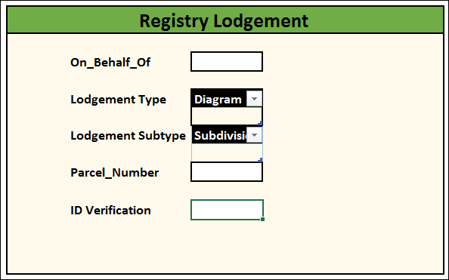
Lodgement Process Flow
After successful login user can request for lodgement by providing requested details.

Slide 36
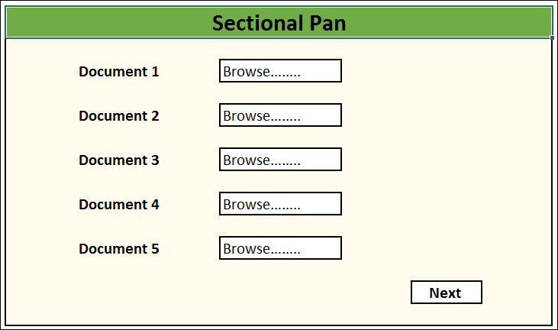
Lodgement Process Flow
Submissions are made online or via registry are being scrutinized in order to see if all relevant documentation is received (including relevant consents and relevant proof of payments, report, field book, co-ordinate list, working plan etc).
If there is a job that is being submitted without property numbers included for the survey, the request is being made to the information section in order for them to reserve numbers for the relevant survey (this delay the lodgement process because you can’t lodge any work without the property numbers).

Slide 37
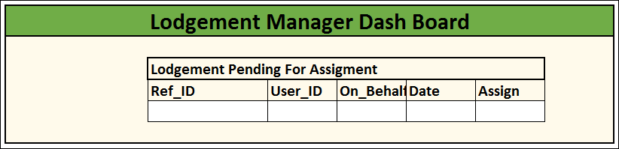
Lodgement Process Flow
Once the user submit the request it will be routed to lodgement manager to assign the request to the lodgement officer in order to carry out necessary action and fulfil the request.

Slide 38
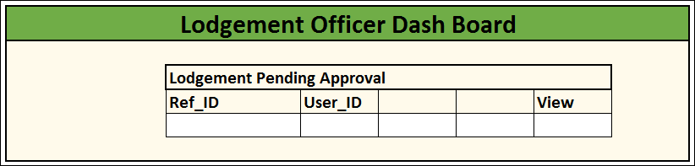
Lodgement Process Flow
On received of the invoices and receipts the jobs are now ready for lodgement.

Slide 39
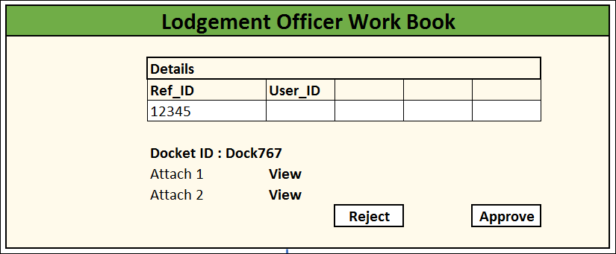
If all the documents is on hand ready, the lodgement is being done.
The batch number and sg numbers (diagrams & general plans), d numbers (sectional title plans) and SR numbers (survey records numbers) etc and create the relevant docket with all the relevant document numbers on it for each job/batch.
An acknowledgement letter for the client in order for the client to know that the job has being lodge and to have all the numbers for the job.
Each job are now being packed together and then being send to the 1st level examination section in order for the examination to be done.

Slide 40
Lodgement

Slide 41
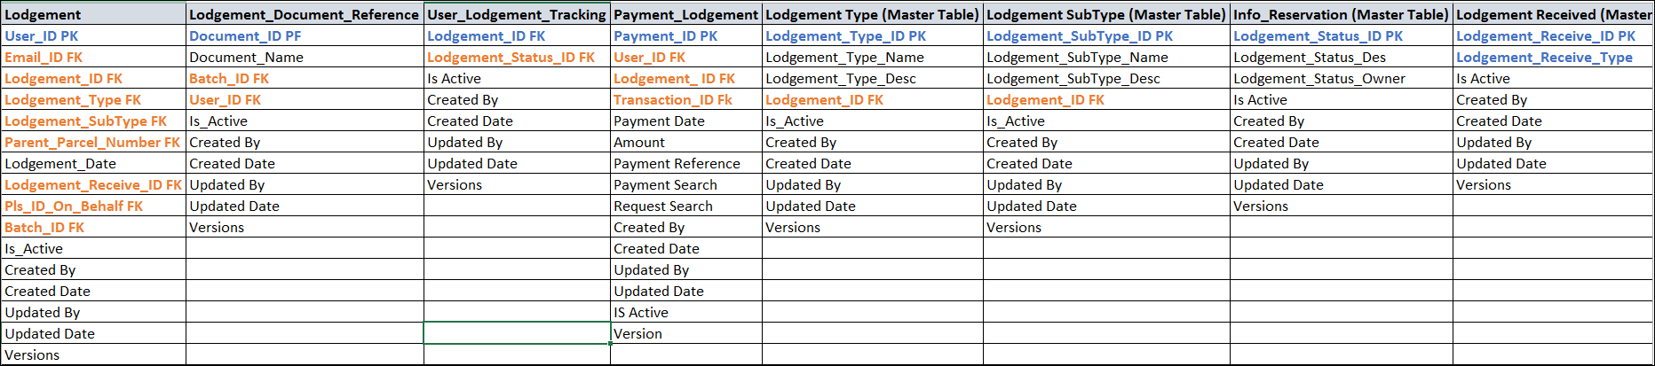
Lodgement Database Tables with Primary and Foreign Key

Slide 42
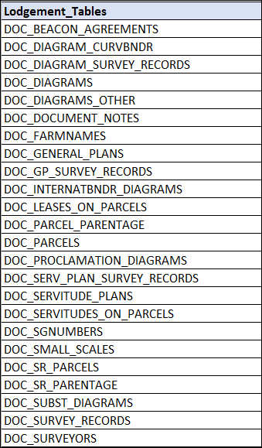
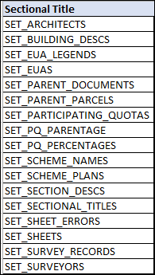
Production Source Existing Tables Details

Slide 43
First Level Examination

Slide 44
Second Level Examination

Slide 45
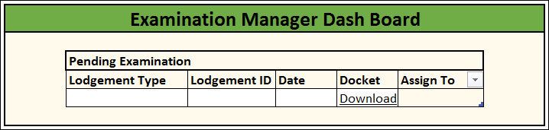
First Level Examination Process Flow
Once the user submit the request it will be routed to examination manager to assign the request to the examination officer in order to carry out necessary action and fulfil the request.

Slide 46
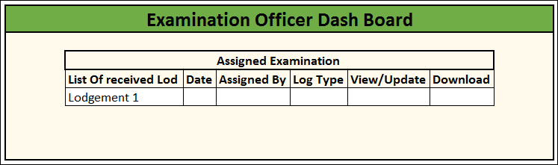
First Level Examination Process Flow
Responsible for the examination of diagrams, general plans, sectional title plans and survey records. the examiners sign all docket items and raise relevant notes as to omissions and errors on documents.
They will check and complete the following:
Examination fees
Consents
Scale and plot
Designation
True north
Schedule entry etc…….

Slide 47
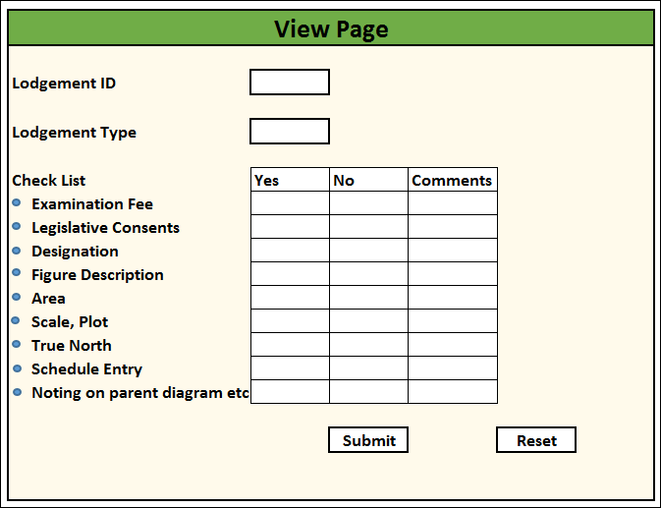
First Level Examination Process Flow

Slide 48
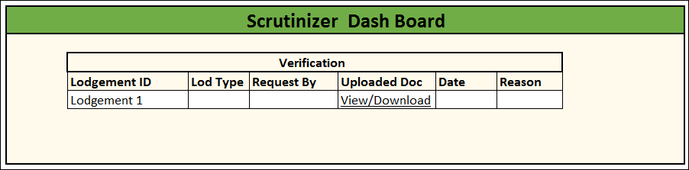
First Level Examination Process Flow
Scrutinize the work completed by the examiners
Investigate and deal with the more complex queries
In case of job is rejected the professional assistant should be notified.

Slide 49
Data Capture
Capture alpha-numeric data from new and historic documents
Diagrams, general plans , survey records
Ensure the reliability of data
Consistency checks: checks for correctness of all numeric data and property extents

Slide 50
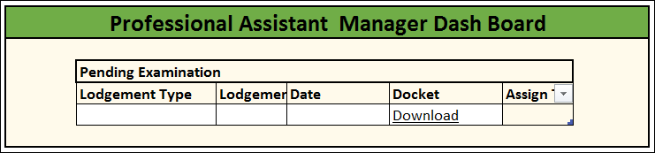
Second Level Examination
After first level examination is done the request it will be routed to professional assistant manager to assign the request to the professional assistant for approval and reject process.

Slide 51
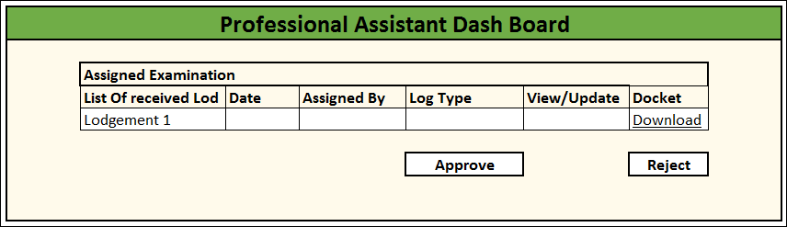
Second Level Examination Process Flow
Check the relevant notes raised by the examiners and scrutinizers.
Check consents
Will either approved or reject a job.
They will also ensure that all approved documents are signed.
Documents which have been approved will be dispatched.

Slide 52
Examination

Slide 53
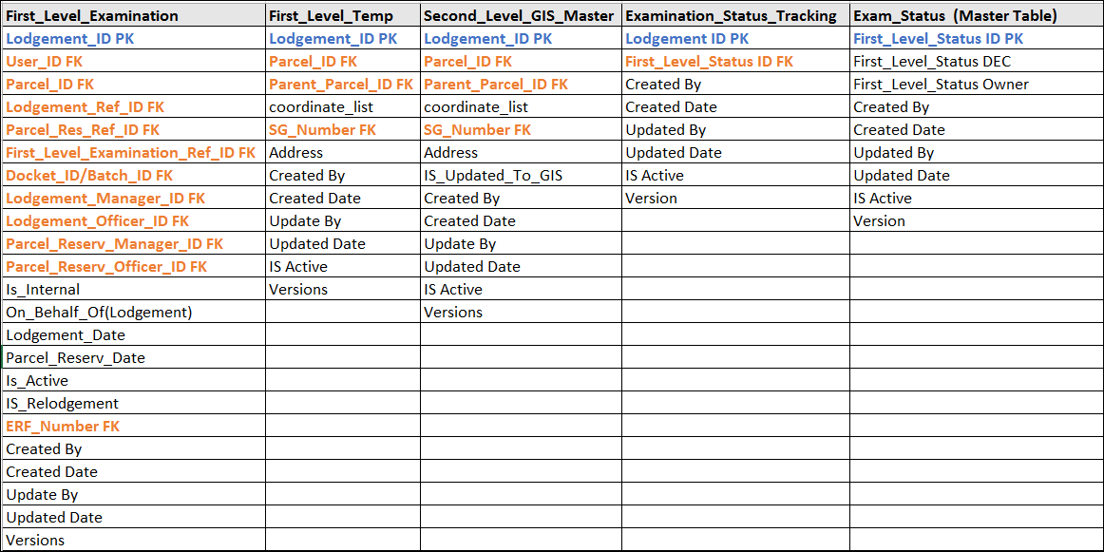
Examination Database Tables with Primary and Foreign Key
Examination

Slide 54
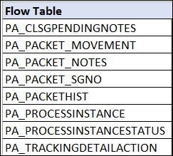

Existing Production Tables Details

Slide 55

Archival Process Flow
Scanning of post approval batches
Rescanning of amended and endorsed documents
Scan on demand
Scanning of historical survey records
Approved batches are physically received
Batches are then allocated to staff for scanning, quality control with supervisor and verification at data capture.

Slide 56

Archival Process Flow
Scan officer will receive the request assigned by scan manager and perform the scanning.
Send the scanned documents to scan manager for quality assurance check.

Slide 57

Archival Process Flow
After quality assurance check is completed then sent to print services

Slide 58

Archival Process Flow
Scan officer will generate the docket after scanning the document
Upon submission system will generate scan id which consist of.
System date
Time
Province
Office
Registration division

Slide 59

Archival Process Flow
Scan id will be update on scan manager dashboard

Slide 60

Archival Process Flow
Data capture attaches filing sheets and dummy diagrams to batches as and when required.
Batches are then sent to print services via office messenger for registration copies to be prepared.

Slide 61

Archival Process Flow
Scan id will be update on scan manager and scan officer dashboard
Rejection form quality assurance will route document to scan office for another iteration of the process

Slide 62

Archival Process Flow
Once the new approved scan (scan id) generated request it will be routed to archival manager to assign the request to the archival officer in order to carry out necessary action and fulfil the request.

Slide 63

Archival Process Flow
Archival officer will trigger the archival process in the system.

Slide 64

Production Source Existing Tables Details

Slide 65
Archiving

Slide 66
Document Tracking

Slide 67
Historical Records Archiving

Slide 70


Production Source Existing Tables Details

Slide 71
Maitenance

Slide 72
Maintenance

Slide 73
Public Place Closure

Slide 74
Duplications

Slide 75
Incorporation preparation

Slide 77

Production Source Existing Tables Details

